Slide 1
Microsoft MakeCode from C++ to TypeScript and Blockly (and back)
C++ Users Group Meeting
April 2018
Thomas Ball and MakeCode team
Notes:
Title
Microsoft MakeCode: from C++ to TypeScript and Blockly (and Back)
Speaker
Thomas Ball, Principal Researcher, Microsoft Research
http://research.microsoft.com/~tball/
Abstract
Across the globe, it is now commonplace for educators to engage in the making (design and development) of embedded systems in the classroom to motivate and excite their students. This new domain brings its own set of unique requirements. Historically, embedded systems development requires knowledge of languages such as C and C++, local installation of compilation toolchains, device drivers and applications. For students and educators, these requirements introduce unnecessary barriers and restrictions.
Over the last two years, Microsoft has invested in a new web-based programming platform for embedded systems in education, called Microsoft MakeCode (www.makecode.com), in partnership with Lancaster University, who created the C++ Component-oriented Device Abstraction Layer (https://github.com/lancaster-university/codal). In this talk, I’ll describe the design principles behind MakeCode and CODAL and our experience with it to date. In particular, I’ll describe how our stack exposes C++ in the browser via TypeScript and Blockly programming APIs, with an in-browser compiler tool chain that produces executable files without the need for a C++ compiler in the core end-user experience. MakeCode is open source at http://github.com/microsoft/pxt
Bio
Thomas (Tom) Ball is a principal researcher and manager at Microsoft Research. In 1999, He initiated the influential SLAM software model-checking project with Sriram Rajamani, which led to the creation of the Static Driver Verifier tool for finding defects in Windows device drivers. Tom is a 2011 ACM Fellow for ‘contributions to software analysis and defect detection’. As a manager, he has nurtured research areas such as automated theorem proving, program testing/verification and empirical software engineering. His current focus is the Microsoft Makecode platform for programming with physical computers.

Slide 2


Microsoft MakeCode Hands-on Computing for every student
Just works always, everywhere
Physical computing a more inclusive approach to CS education
Path to real-world skills
Extensible platform for partners

Slide 3
Microsoft MakeCode Objectives
Usage – Increased diversity and number of students engaged/interested in computing and technology
Brand – Microsoft recognized as an innovator in computing education
Ecosystem – Democratizing access to the world of intelligent edge devices and enabling a thriving partner ecosystem

Slide 4
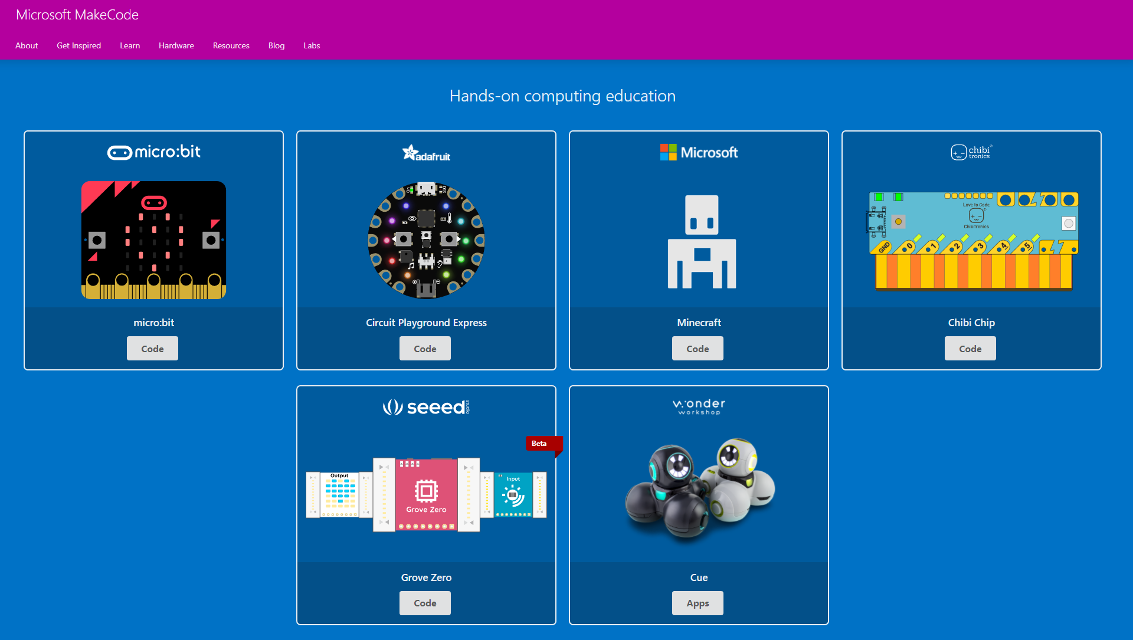
www.makecode.com
Notes:
Demo of adafruit

Slide 5
The Web
(browser)
Plentiful RAM
World of great frameworks
for beginning programming
(Blockly)
Web App
JavaScript
Single-threaded
TypeScript
our contribution
bringing the worlds of
Web and MCU together
MakeCode = integration/entry point
Languages, Compilers, Runtime
C++
CODAL
Reactive/
concurrent
Full bare-metal binary
The microcontroller
(MCU)
Little RAM
World of the pro IDE
(Eclipse, VS, VS Code)

Slide 6
Innovations
Web app for end-to-end experience
no install or need for C/C++ compiler for end-user
in-browser compilation to binary
TypeScript as core language
API mapping: up to Blockly and down to C++
coverage of OO concepts
Runtime abstractions
Events, message bus and co-routines
support concurrent, reactive programming
Blockly
TypeScript
C++
Notes:
web based editor: nothing to install
cross platform: works in most modern browsers from tiny phone to giant touch screens
compilation in the browser: the compiler runs in your browser, it's fast and works offline
blocks + JavaScript: drag and drop blocks or type JavaScript, MakeCode let's you go back and forth between the two.
works offline: once you've loaded the editor, it stays cached in your browser.
event based runtime: easily respond to button clicks, shake gestures and more

Slide 7
TypeScript
Gradually typed superset of JavaScript
Compiles to JavaScript
Supports ECMAScript 2015 and latest language features
Types enable productivity tools
intellisense, navigation, refactoring
http://www.typescriptlang.org/

Slide 8
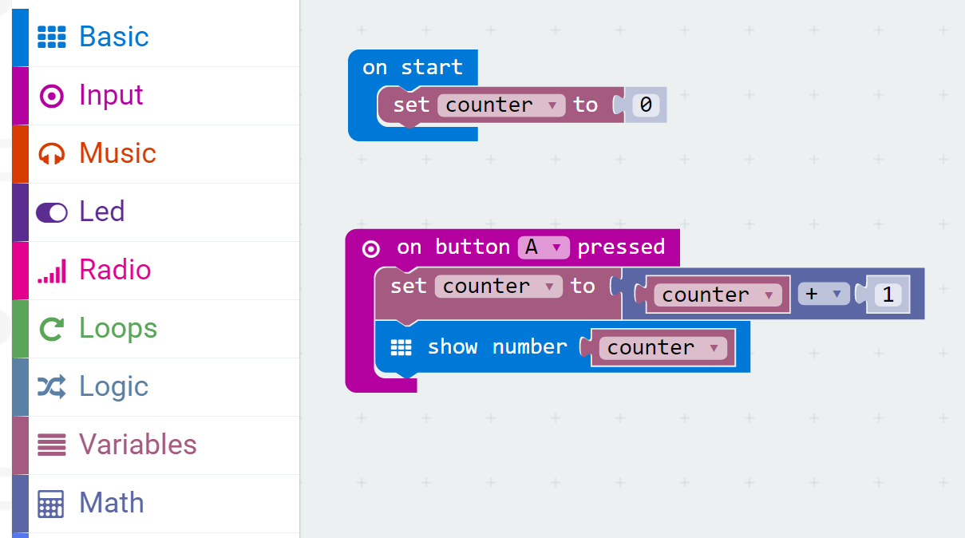
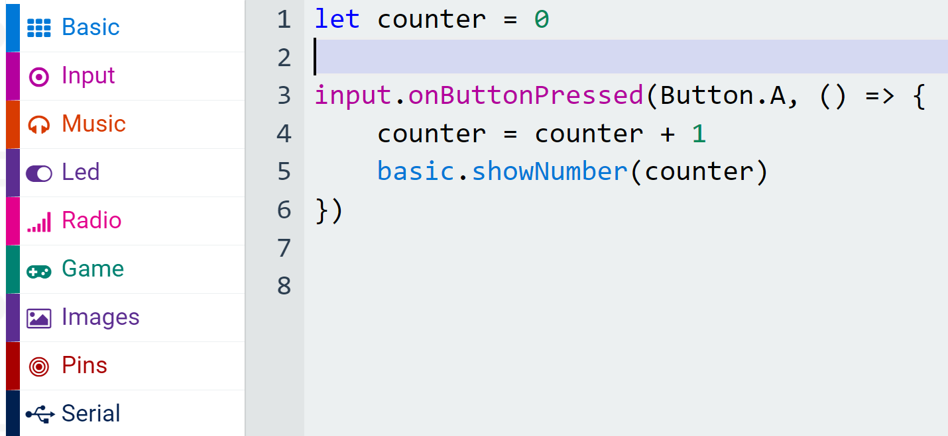
Blocks and TypeScript
Blockly
TypeScript
Categories
Namespaces

Slide 9
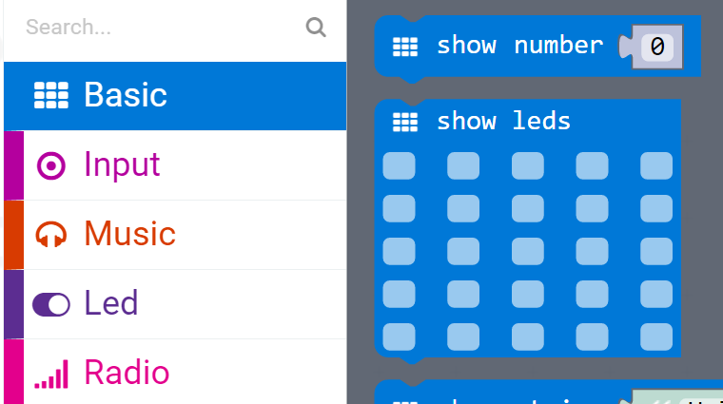
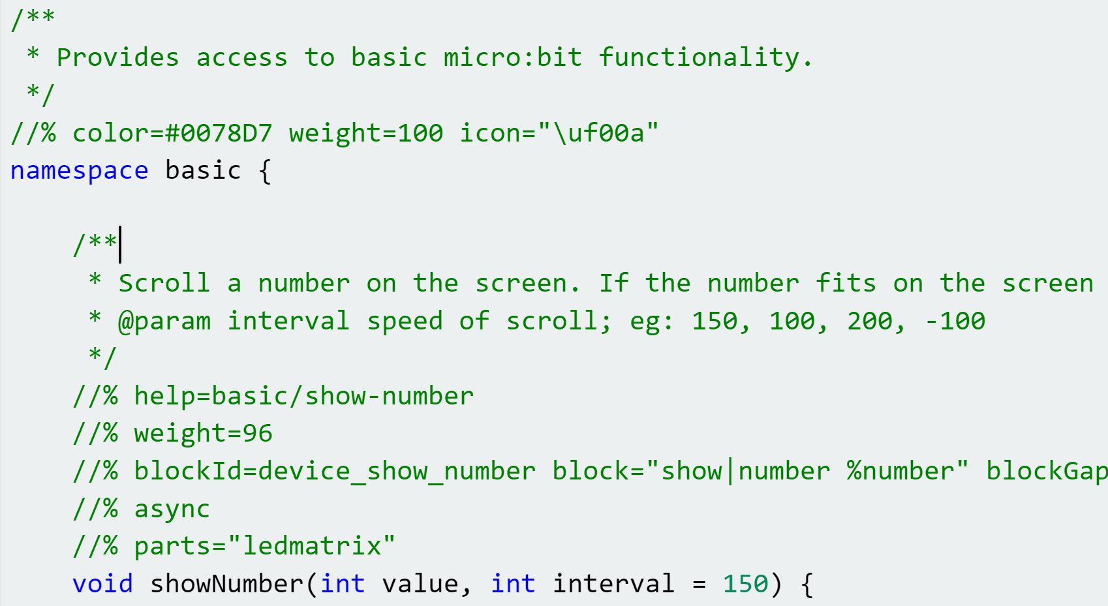
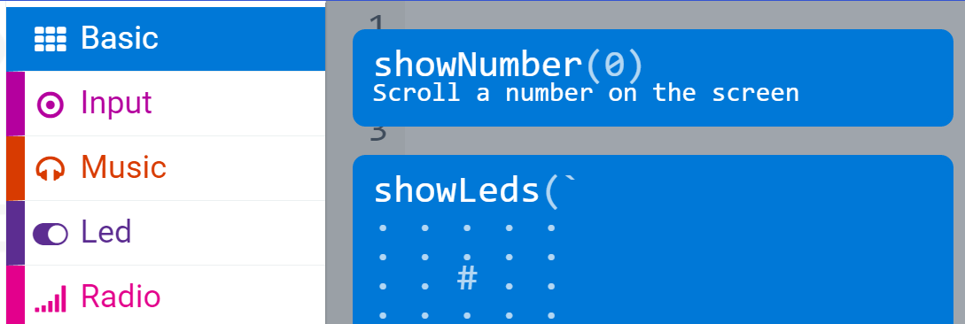
API Binding (1)
Blockly
C++
TypeScript

Slide 10
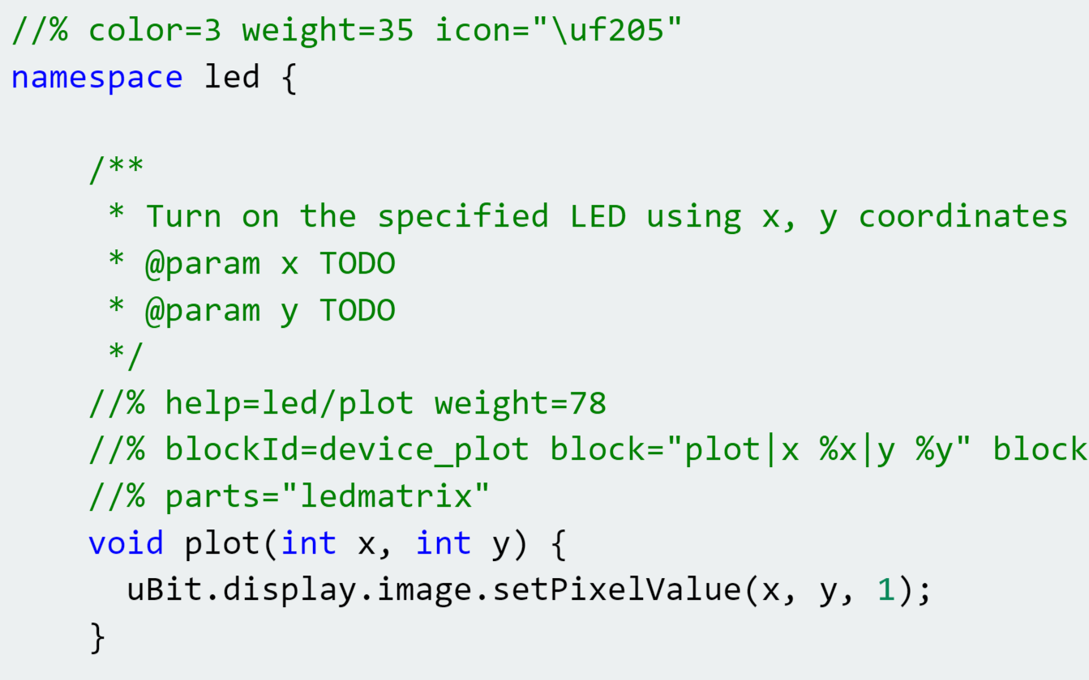
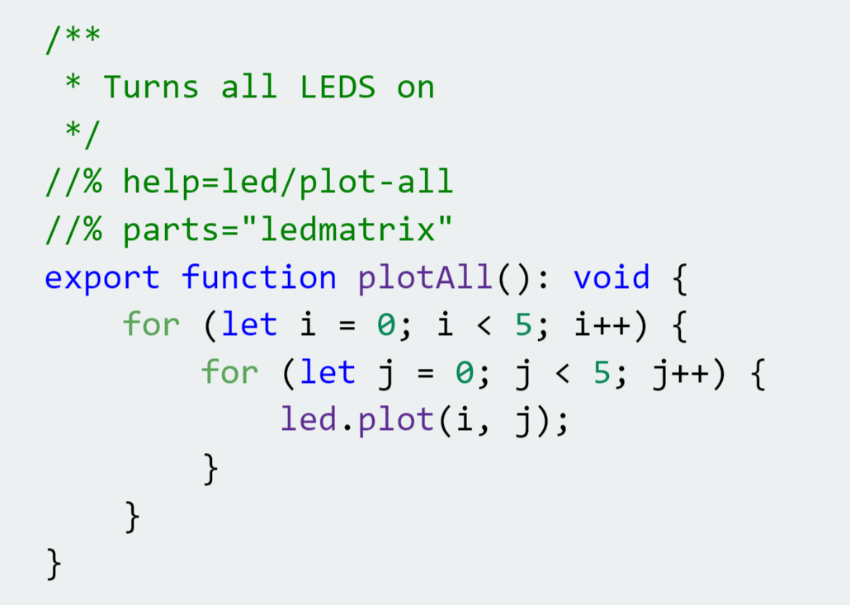
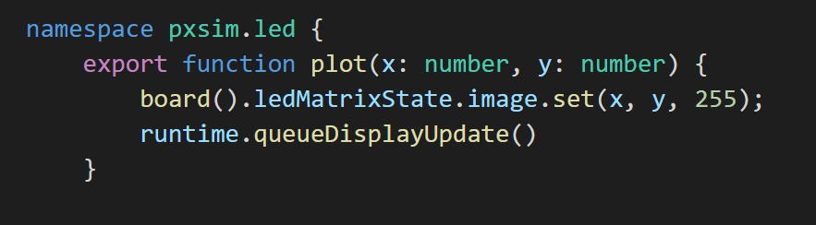
C++
API Binding (2)
Wrapping micro:bit runtime
Runtime extension
TypeScript
Simulator implementation

Slide 11
Editors
Simulator
Web App
Blockly
JavaScript
Monaco
TypeScript
IR
Assembly
user
binary
TypeScript
Device
runtime
Linker
TypeScript
runtime
binary
cached copy
final binary
C++
runtime
binary
compile
Cloud compilation
decompile
link
Notes:
We can call blockly from C++ and C++ from blockly (TypeScript mediated)

Slide 12
1. From C++ to TypeScript and Blockly
CODAL: C++ Component-oriented Device Abstraction Layer
https://github.com/lancaster-university/codal-core
Joe Finney and James Devine
http://github.com/microsoft/pxt-common-packages
glue between CODAL and MakeCode
annotated C++ provides standard TypeScript/Blockly APIs for common features
http://github.com/microsoft/pxt-adafruit
Defines full web app
Using common packages and base PXT framework

Slide 13
codal-core
extends,
implements
codal-atmega328p
uses
codal-arduino-uno
codal
(build shell)
codal-samd21
selects from
uses
codal-circuit-playground
Notes:
https://github.com/lancaster-university/codal-adafruit-cplay
Installing dependencies...
codal-core is already installed
mbed-classic is already installed
codal-samd21 is already installed
codal-mbed is already installed
Using library: codal-circuit-playground
Using library: codal-core
Using library: mbed-classic
Using library: codal-samd21
Using library: codal-mbed
-- Configuring done

Slide 14
CODAL repos
Build: https://github.com/lancaster-university/codal
Base: https://github.com/lancaster-university/codal-core
https://github.com/lancaster-university/codal-mbed
https://github.com/lancaster-university/codal-samd21
https://github.com/lancaster-university/codal-circuit-playground
https://github.com/lancaster-university/codal-atmega328p
https://github.com/lancaster-university/codal-arduino-uno
…

Slide 15
codal-core
extends,
implements
codal-atmega328p
uses
codal-arduino-uno
codal
(build shell)
codal-samd21
selects from
uses
codal-circuit-playground
Notes:
https://github.com/lancaster-university/codal-adafruit-cplay
Installing dependencies...
codal-core is already installed
mbed-classic is already installed
codal-samd21 is already installed
codal-mbed is already installed
Using library: codal-circuit-playground
Using library: codal-core
Using library: mbed-classic
Using library: codal-samd21
Using library: codal-mbed
-- Configuring done

Slide 16
codal-core
Blockly,
Typescript, Monaco
pxt
uses
references
extends,
implements
codal-atmega328p
pxt-common-packages
references
uses
codal-arduino-uno
codal
(build shell)
codal-samd21
selects from
uses
codal-circuit-playground
Notes:
https://github.com/lancaster-university/codal-adafruit-cplay
Installing dependencies...
codal-core is already installed
mbed-classic is already installed
codal-samd21 is already installed
codal-mbed is already installed
Using library: codal-circuit-playground
Using library: codal-core
Using library: mbed-classic
Using library: codal-samd21
Using library: codal-mbed
-- Configuring done

Slide 17
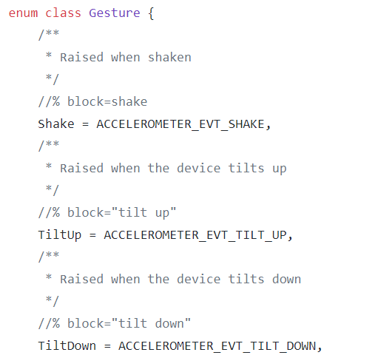
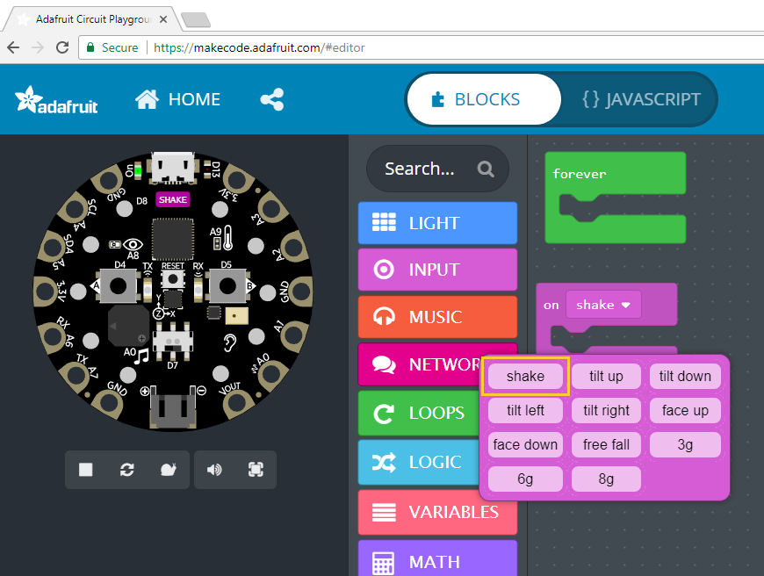
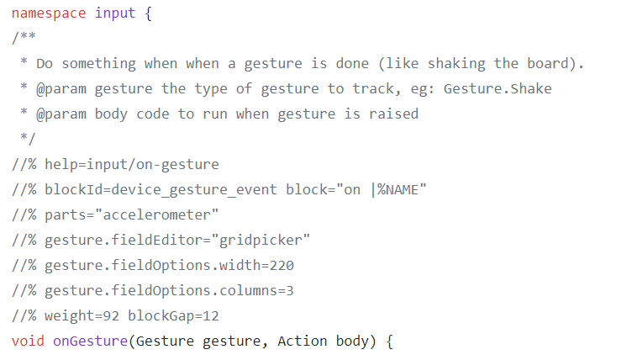
https://github.com/Microsoft/pxt-common-packages/blob/master/libs/accelerometer/accelerometer.cpp

Slide 18
codal-core
Blockly,
Typescript, Monaco
pxt
uses
references
extends,
implements
codal-atmega328p
pxt-common-packages
references
uses
codal-arduino-uno
codal
(build shell)
codal-samd21
selects from
uses
codal-circuit-playground
Notes:
https://github.com/lancaster-university/codal-adafruit-cplay
Installing dependencies...
codal-core is already installed
mbed-classic is already installed
codal-samd21 is already installed
codal-mbed is already installed
Using library: codal-circuit-playground
Using library: codal-core
Using library: mbed-classic
Using library: codal-samd21
Using library: codal-mbed
-- Configuring done

Slide 19
codal-core
Blockly,
Typescript, Monaco
pxt
uses
references
extends,
implements
codal-atmega328p
pxt-common-packages
references
uses
codal-arduino-uno
uses
codal
(build shell)
uses
pxt-target
extends,
implements
codal-samd21
selects from
uses
codal-circuit-playground
MakeCode web app
Notes:
https://github.com/lancaster-university/codal-adafruit-cplay
Installing dependencies...
codal-core is already installed
mbed-classic is already installed
codal-samd21 is already installed
codal-mbed is already installed
Using library: codal-circuit-playground
Using library: codal-core
Using library: mbed-classic
Using library: codal-samd21
Using library: codal-mbed
-- Configuring done

Slide 20
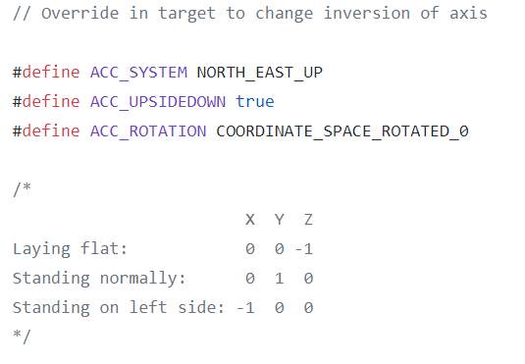
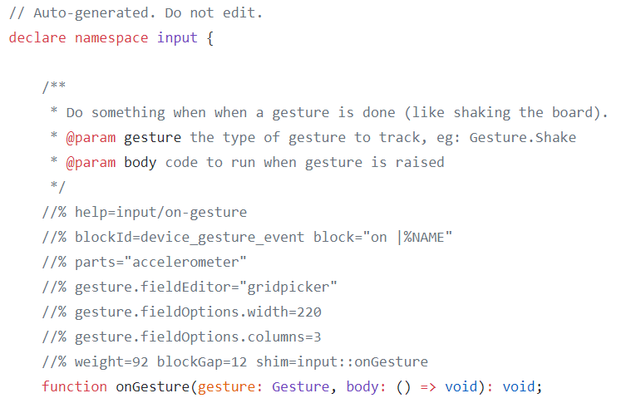
Target specific override and shim file
https://github.com/Microsoft/pxt-adafruit/blob/master/libs/accelerometer/axis.h
https://github.com/Microsoft/pxt-adafruit/blob/master/libs/accelerometer/shims.d.ts

Slide 21
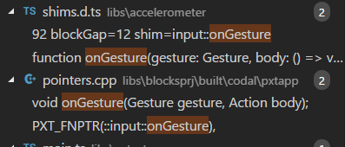
Compiling C++ for MakeCode
Preprocessing of C++
https://makecode.com/simshim
Determines which C++ entities will be visible/exported via TypeScript Declaration File
Mosly 1-1 mappings between C++ and TypeScript entities
bool, number(s), string, enums
lambdas, functions
namespaces
runtime collections
plus a hack for exposing methods of a C++ class
Invoke C++ compiler to generate runtime binary
With exported points
Binary incorporated into web app

Slide 22
MakeCode GitHub repos
Framework and support
https://github.com/Microsoft/pxt
https://github.com/Microsoft/pxt-blockly
https://github.com/Microsoft/pxt-monaco-typescript
https://github.com/Microsoft/pxt-common-packages (CODAL-specific)
Targets
https://github.com/Microsoft/pxt-adafruit
https://github.com/Microsoft/pxt-microbit
https://github.com/Microsoft/pxt-maker
https://github.com/Microsoft/pxt-chibitronics

Slide 23
2. From Blocky to TypeScript to Binary (C++)
Static TypeScript
Blocky to Static TypeScript
Compiling Static TypeScript to Machine Code

Slide 24
Static TypeScript
Considerations
Compile for low-memory footprint
Link against pre-compiled C++ runtime
All types known at compile time, no runtime checks
TypeScript without the Any type and “bad parts”
a subset of TypeScript, with some type substitutions (number -> int32)
excludes
the eval function, the with statement, the typeof expression
type assertions, var statement
access to prototype property and computed properties
access to the “this” pointer outside of a class

Slide 25
What’s Left in Static TypeScript?
standard control-flow statements
let and const: lexically-scoped variable declarations
functions (nested) and lambdas
classes with instance fields, methods and constructors
interfaces
generic classes, methods, and functions for code reuse
namespaces

Slide 26
Blocky to Static TypeScript
Blockly has limited notion of type
Perform Hindley-Milner type inference over Blockly AST
Type errors possible in Blockly, but very rare

Slide 27
Static TypeScript to Machine Code
TypeScript language service -> typed AST
Extra checks for Static TypeScript subset
AST -> IR -> Assembly -> Machine Code
Tree shaking of AST to remove all unneeded STS code

Slide 28
Compiler and Runtime
Tagged integers, boxing to move to doubles (JavaScript)
Automatic conversion from STS numbers to various C++ types in glue code
Reference counting
Closures
Vtable-based layout of (nominally typed) classes
Interfaces (i.e., multiple inheritance)
this is done per-method, so classes do not have to declare they implement a particular interface
Generics (through code duplication for now)
Many ES6 features (for-in, string templates, lambda expressions, get/set accessors, etc.)
Custom debugger support for both native and JS compilers
https://github.com/Microsoft/pxt-common-packages/blob/master/libs/base/pxtbase.h

Slide 29
The Web
(browser)
Plentiful RAM
World of great frameworks
for beginning programming
(Blockly)
Web App
JavaScript
Single-threaded
TypeScript
our contribution
bringing the worlds of
Web and MCU together
MakeCode = integration/entry point
Languages, Compilers, Runtime
C++
CODAL
Reactive/
concurrent
Full bare-metal binary
The microcontroller
(MCU)
Little RAM
World of the pro IDE
(Eclipse, VS, VS Code)

